Slide 1
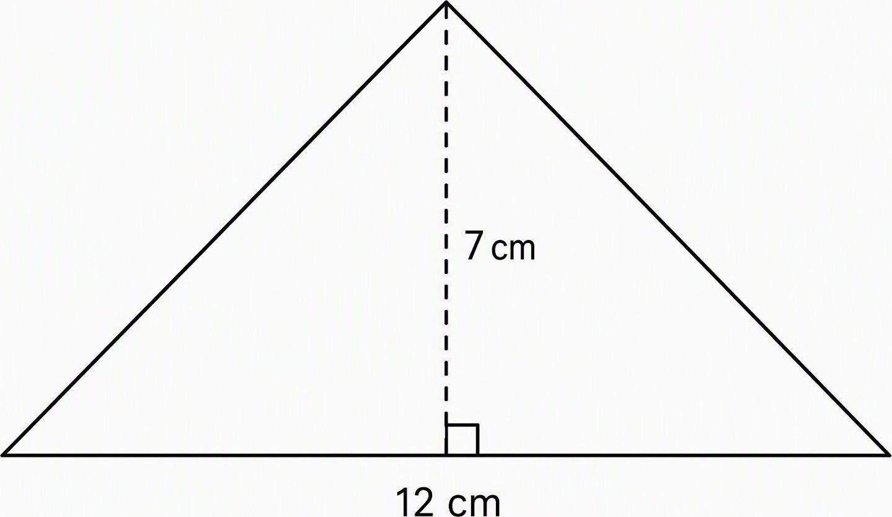
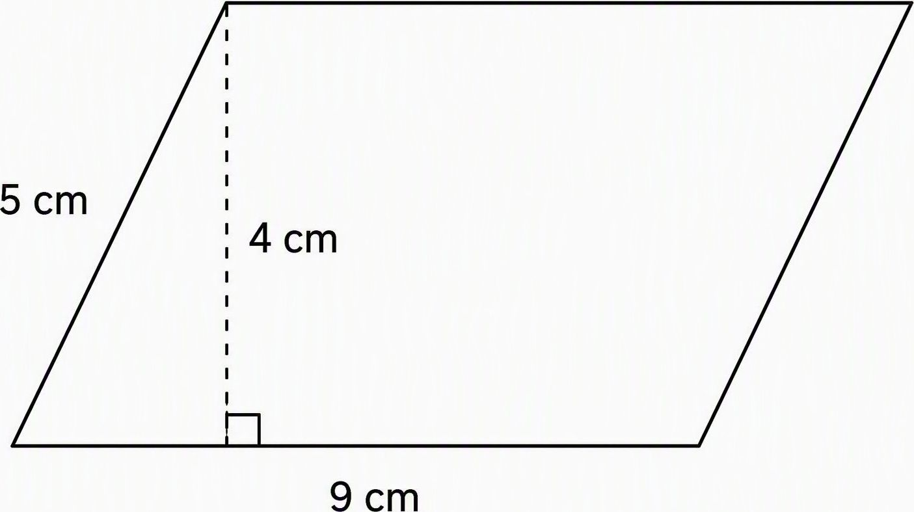
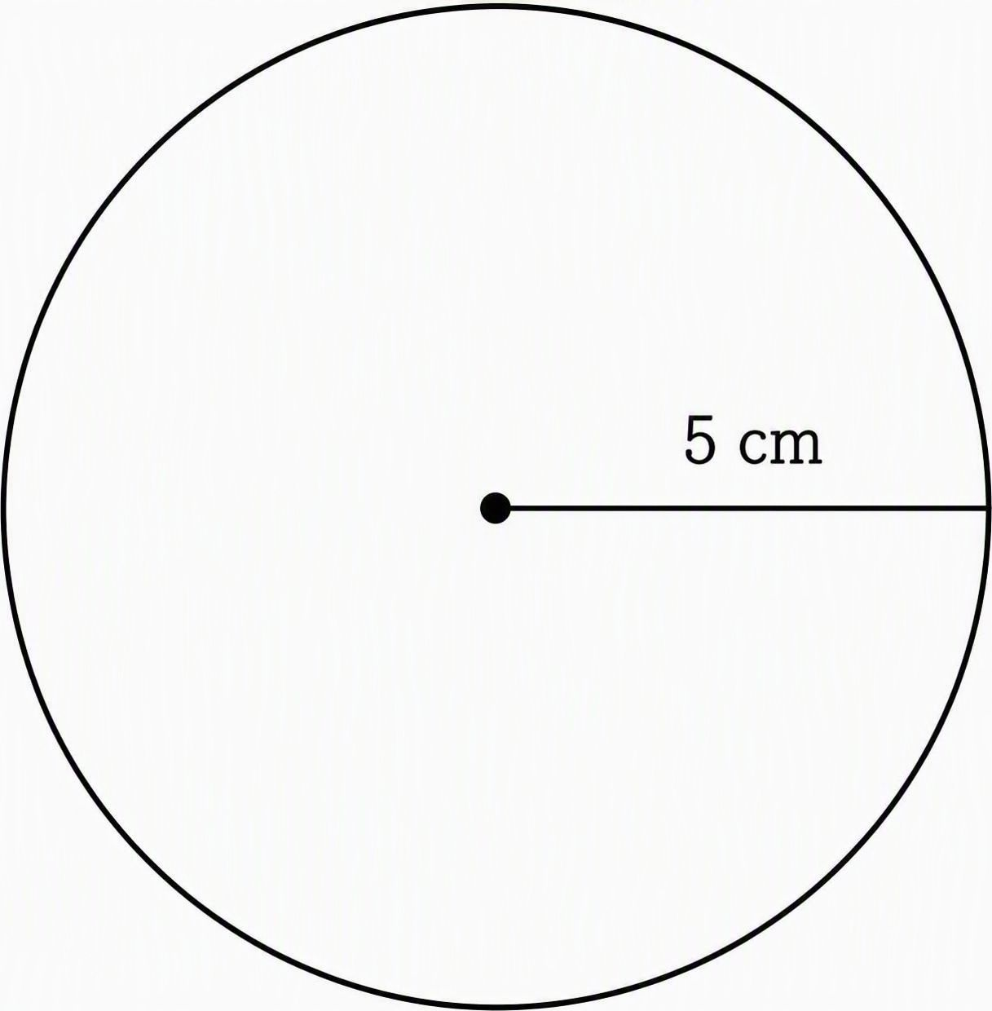
Geometry & measurement
Alberta Grade 7 mathematics
Name: __________________________ Date: __________________
Show your steps and include units. Use π ≈ 3.14. Diagrams are not to scale.
Triangle A = bh ÷ 2 Parallelogram A = bh Circle C = 2πr, A = πr²
Triangles
1. Find the area of the triangle shown.
2. A triangle has area 45 cm² and base
10 cm. Find its height.
Parallelograms
3. Find the area of the parallelogram.
4. Why is the height 4 cm rather than
the sloping side length of 5 cm?
Circles
5. Find the circle’s diameter and
circumference.
6. Find the area of the same circle.
Check: lengths use cm. Areas use cm².
Notes:
TEACHER ANSWER KEY
1. A = 12 × 7 ÷ 2 = 42 cm².
2. 45 = 10h ÷ 2, so h = 9 cm.
3. A = 9 × 4 = 36 cm².
4. Height is the perpendicular distance between the parallel bases. The 5 cm side is slanted and is not perpendicular to the base.
5. d = 2 × 5 = 10 cm. C ≈ 2 × 3.14 × 5 = 31.4 cm.
6. A ≈ 3.14 × 5² = 78.5 cm².
CURRICULUM BASIS
Calgary Board of Education, Alberta Education 7–9 Mathematics Program of Studies Overview, Grade 7: relationships among radius, diameter and circumference; formulas for areas of triangles, parallelograms and circles. https://cbe.ab.ca/get-involved/school-councils/documents/alberta-ed-math7-12.pdf (accessed 22 October 2026). This worksheet practises selected outcomes, not the entire geometry strand.
All problems are original practice examples. Geometry diagrams are AI-generated illustrations, not to scale.
PRINTING
Slide size is 8.5 × 11 inches, portrait. Print one full-page slide on letter paper. Answer key stays in speaker notes.

Slide 2
Geometry & measurement
Teacher page: answer key & quick lesson
Alberta Grade 7 mathematics
Answer key
1. Triangle area
2. Missing triangle height
A = bh ÷ 2 = 12 × 7 ÷ 2 = 42 cm²
h = 2A ÷ b = 2 × 45 ÷ 10 = 9 cm
3. Parallelogram area
4. Perpendicular height
A = bh = 9 × 4 = 36 cm²
The 4 cm height meets the base at 90°.
The 5 cm sloping side is not the height.
5. Circle diameter and circumference
6. Circle area
d = 2r = 2 × 5 = 10 cm
C ≈ 2 × 3.14 × 5 = 31.4 cm
A ≈ 3.14 × 5² = 78.5 cm²
Quick lesson plan
Suggested 30-minute review lesson
Goal: Choose the correct measurements and formulas, show steps, and use units.
Materials: Student worksheet, pencils, calculator and board.
3 min Warm-up
Ask students to identify a base and perpendicular height. Review radius
and diameter, then distinguish distance around from area inside.
7 min Model
Work a triangle example: b = 8 cm, h = 3 cm, A = 12 cm². Review
A = bh, C = 2πr and A = πr². Emphasize the right-angle height.
12 min Practise
Students complete questions 1–6. Circulate and check formula choices.
Prompt students to use π ≈ 3.14 and label cm or cm².
5 min Discuss
Compare answers. Ask why question 4 uses 4 cm instead of 5 cm.
Address radius/diameter mix-ups and forgetting to halve triangle area.
3 min Exit check
A circle has radius 3 cm. Find its diameter and area.
Expected: d = 6 cm and A ≈ 28.26 cm². Use responses to plan reteaching.
Support: Label b, h and r before substituting. Extension: Double a circle’s radius.
Ask how circumference and area change. Expected: ×2 and ×4.
Notes:
Teacher companion to slide 1. Original suggested review lesson. Answer key uses the worksheet dimensions and π ≈ 3.14. Curriculum basis retained from worksheet: https://cbe.ab.ca/get-involved/school-councils/documents/alberta-ed-math7-12.pdf. Print slide 2 as one full-page slide on portrait letter paper.

